Slide 1
Broadcast Receivers

Slide 2
Broadcasts
Broadcasts are messages that the Android system and Android apps send when events occur that might affect the functionality of other apps.
For example, the Android system sends an event when the system boots up, when power is connected or disconnected, and when headphones are connected or disconnected.
Your Android app can also broadcast events, for example when new data is downloaded.
In general, broadcasts are messaging components used for communicating across apps when events of interest occur.

Slide 3
Broadcasts
There are two types of broadcasts:
System broadcasts are delivered by the system.
Custom broadcasts are delivered by your app.

Slide 4
System broadcasts
A system broadcast is a message that the Android system sends when a system event occurs.
System broadcasts are wrapped in Intent objects.
The intent object's action field contains event details such as android.intent.action.HEADSET_PLUG, which is sent when a wired headset is connected or disconnected.
The intent can also contain more data about the event in its extra field, for example a boolean extra indicating whether a headset is connected or disconnected.

Slide 5
System broadcasts
Examples:
When the device boots, the system broadcasts a system Intent with the action ACTION_BOOT_COMPLETED.
When the device is disconnected from external power, the system sends a system Intent with the action field ACTION_POWER_DISCONNECTED.
System broadcasts aren't targeted at specific recipients. Interested apps must register a component to "listen" for these events.
This listening component is called a broadcast receiver.

Slide 6
Custom broadcasts
Custom broadcasts are broadcasts that your app sends out.
Use a custom broadcast when you want your app to take an action without launching an activity.
For example, use a custom broadcast when you want to let other apps know that data has been downloaded to the device and is available for them to use.
More than one broadcast receiver can be registered to receive your broadcast.

Slide 7
Custom broadcasts
To create a custom broadcast, define a custom Intent action.
Note: When you specify the action for the Intent, use your unique package name (for example com.example.myproject) to make sure that your intent doesn't conflict with an intent that is broadcasted from a different app or from the Android system.

Slide 8
Broadcast receivers
Broadcast receivers are app components that can register for system events or app events.
When an event occurs, registered broadcast receivers are notified via an Intent.
For instance, if you are implementing a media app and you're interested in knowing when the user connects or disconnects a headset, register for the ACTION_HEADSET_PLUG intent action.
Use broadcast receivers to respond to messages that have been broadcast from apps or from the Android system.

Slide 9
Broadcast receivers
To create a broadcast receiver:
Define a subclass of the BroadcastReceiver class and implement the onReceive() method.
Register the broadcast receiver, either statically or dynamically.

Slide 10
Subclass a BroadcastReceiver
To create a broadcast receiver, define a subclass of the BroadcastReceiver class.
This subclass is where Intent objects are delivered if they match the intent filters you register for.
Within your subclass:
Implement the onReceive() method, which is called when the BroadcastReceiver object receives an Intent broadcast .
Inside onReceive(), include any other logic that your broadcast receiver needs.

Slide 11
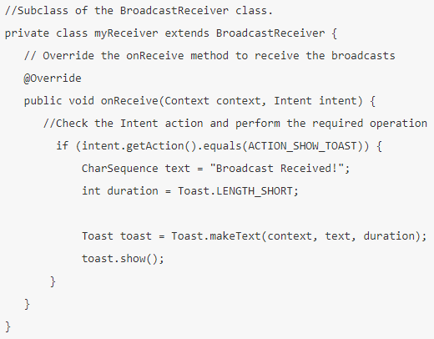
Subclass a BroadcastReceiver
In this example, the myReceiver class a subclass of BroadcastReceiver.
If the incoming broadcast intent has the ACTION_SHOW_TOAST action, the myReceiver class shows a toast message.
The onReceive() method is called when your app receives a registered Intent broadcast.

Slide 12
Subclass a BroadcastReceiver
The onReceive() method runs on the main thread unless it is explicitly asked to run on a different thread.
The onReceive() method has a timeout of 10 seconds.
After 10 seconds, the Android system considers your receiver to be blocked, and the system might show the user an "application not responding" error.
For this reason, you shouldn't implement long-running operations in onReceive().

Slide 13
Subclass a BroadcastReceiver
In particular:
Don't try to show a dialog from within a BroadcastReceiver.
Instead, display a notification using the NotificationManager API or use Toast.

Slide 14
Register your broadcast receiver and set intent filters
There are two types of broadcast receivers:
Static receivers, which you register in the Android manifest file.
Dynamic receivers, which you register using a context.

Slide 15
Static receivers
Static receivers are also called manifest-declared receivers.
To register a static receiver, include the following attributes inside the <receiver> element in your AndroidManifest.xml file:
android:name: The value for this attribute is the name of the BroadcastReceiver subclass. For example .AlarmReceiver.
android:exported (optional): If this boolean value is set to false, other apps cannot send broadcasts to your receiver. This attribute is important for security.
<intent-filter>: Include this nested element to specify the broadcast Intent actions that your broadcast receiver component is listening for.

Slide 16
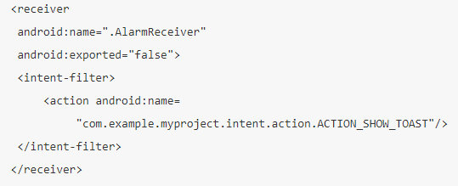
Static receivers
The code snippet shows static registration of a broadcast receiver that listens for a custom broadcast Intent with the action "ACTION_SHOW_TOAST":
The receiver's name is the name of the BroadcastReceiver subclass (.AlarmReceiver).
The receiver is not exported, meaning that no other apps can deliver broadcasts to this app.
The intent filter checks whether incoming intents include an action named ACTION_SHOW_TOAST, which is a custom Intent action defined within the app.

Slide 17
Static receivers
Note: Starting from Android 8.0 (API level 26 and higher), you can't use static receivers to receive most Android system broadcasts, with some exceptions.

Slide 18
Intent filters
An intent filter specifies the types of intents that a component can receive.
When the system receives an Intent as a broadcast, it searches the broadcast receivers based on the values specified in receivers' intent filters.
To create an intent filter statically, use the <intent-filter> element in the Android manifest.
An <intent-filter> element has one required element, <action>.
The Android system compares the Intent action of the incoming broadcast to the filter action's android:name strings.

Slide 19

Intent filters
If any of the names in the filter match the action name in the incoming broadcast, the broadcast is sent to your app.
Following <intent-filter> listens for a system broadcast that's sent when the device boots up.
Only Intent objects with an action named BOOT_COMPLETED match the filter:

Slide 20
Dynamic receivers
Dynamic receivers are also called context-registered receivers.
You register a dynamic receiver using an application context or an Activity context.
A dynamic receiver receives broadcasts as long as the registering context is valid:
If you use the application context to register your receiver, your app receives relevant broadcasts as long as your app is running in either the foreground or the background.
If you use an Activity context to register your receiver, your app receives relevant broadcasts until that Activity is destroyed.

Slide 21

Dynamic receivers
To use the context to register your receiver dynamically:
Create an IntentFilter and add the Intent actions that you want your app to listen for.
When the device power is connected or disconnected, the Android system broadcasts the Intent.ACTION_POWER_CONNECTED and Intent.ACTION_POWER_DISCONNECTED intent actions.

Slide 22

Dynamic receivers
To use the context to register your receiver dynamically:
Register the receiver by calling registerReceiver() method on the context. Pass in the BroadcastReceiver object and the IntentFilter object.
In this example the Activity context (this) is used to register your receiver. So the app will receive the broadcast as long as the Activity is running.

Slide 23
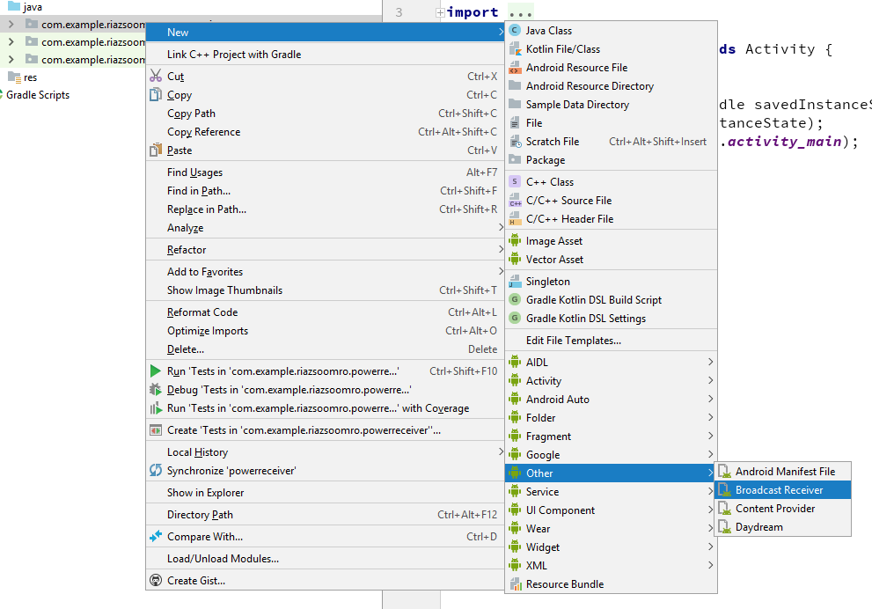
Example: Dynamic receiver

Slide 24

Example: Dynamic receiver
Navigate to your AndroidManifest.xml file.
Android Studio has generated a <receiver> element, but you don't need it, because you can't use a static receiver to listen for power-connection system broadcasts.
Delete the entire <receiver> element.

Slide 25
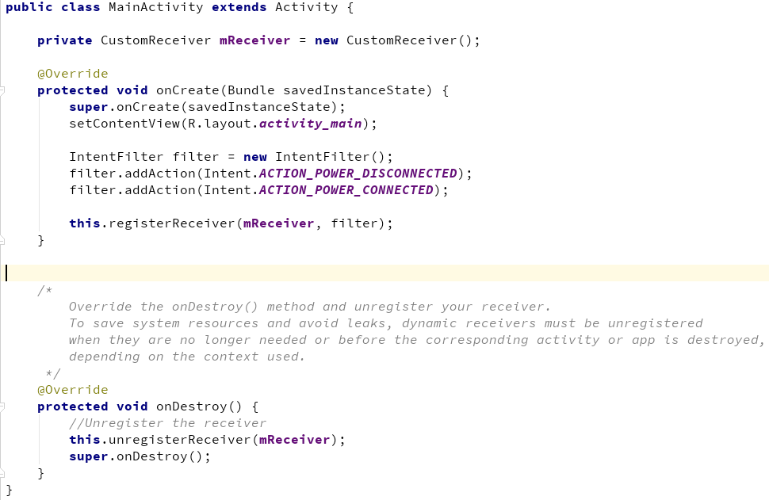
Example: Dynamic receiver

Slide 26
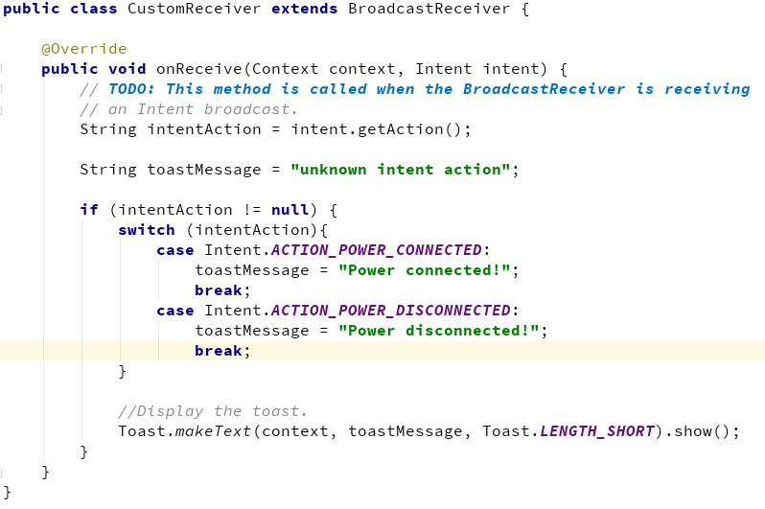
Example: Dynamic receiver

